Slide 1
PREDICTING USED CAR PRICES

Slide 2
INTRODUCTION
Vehicle price prediction, especially when the vehicle is used and not coming directly from the factory, is both a critical and important task. With increase in demand for used cars and upto 8 percent decrease in demand for the new cars in 2013, more and more vehicle buyers are finding alternatives to buying new cars outright. People prefer to buy cars through lease which is a legal contract between buyer and seller.

Slide 3
OBJECTIVES AND SCOPE
The objective is to build an application which can predict the second hand used car price for the buyer and the seller.
This would help the online viewer on OLX and other online platforms where users buy the second hand car can predict its price easily.

Slide 4
DATASET AND PRE-PROCESSING
Vehicle dataset from cardekho available on kaggle.
Above dataset contains many outliers, primarily due to large price sensitivity of used cars. Which is then pruned to 3 standard deviations around the mean in order to remove those outliers.
Few features from dataset were removed as they do not contribute much in analyzing like Car_name etc.

Slide 5
MODEL IMPLEMENTATION
Whole dataset were split into training(90%) and testing(10%).
Models built are:
Random Forest - Belongs to the category of ensemble methods. Used for classification and Regressions.
Artificial Neural Networks - Same way as human brain works. Uses artificial neurons which is connected via weighted metrics. These weights are adjusted while training.
SVM - Used for classification and regression. It makes a binary decision and decide in which among the two categories the input sample belongs.

Slide 6
EVALUATION
We use pairplot of Seaborn python library for finding the correlation between the variables.
Map provided does not contain enough information so we tried to plot again with the heat map.
Use the random grid to search for best hyperparameters
First created the base model to tune and then Random search of parameters, using 3 fold cross validation,
Search across 100 different combinations

Slide 7
CONCLUSION
None of the classifier gives appropriate result.
Thus, Ensemble Method was proposed.
Ensemble Methods combines three ML algorithms that were applied in the first experiment as single classifiers: RF, ANN, SVM.
Combination of multiple ML classifiers strengthens the classification performance overall.

Slide 8
GUI APPLICATION
The final prediction system has been incorporated into the Spyder application for creating the front end user interface for the car price prediction. The simple application GUI, shown below in Fig. enables potential car buyers to estimate the price of the desired car.

Slide 9
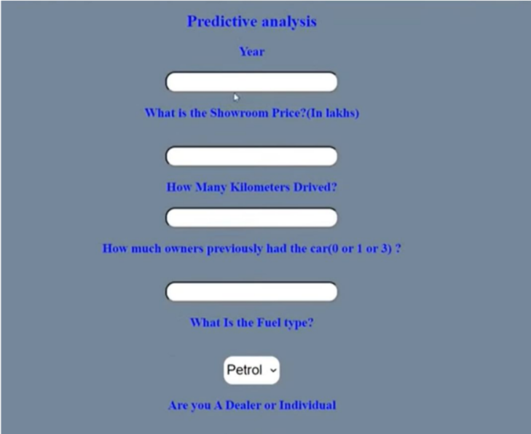

Slide 10



